Slide 1
The EDI Cube
Alternative graphics

Slide 2
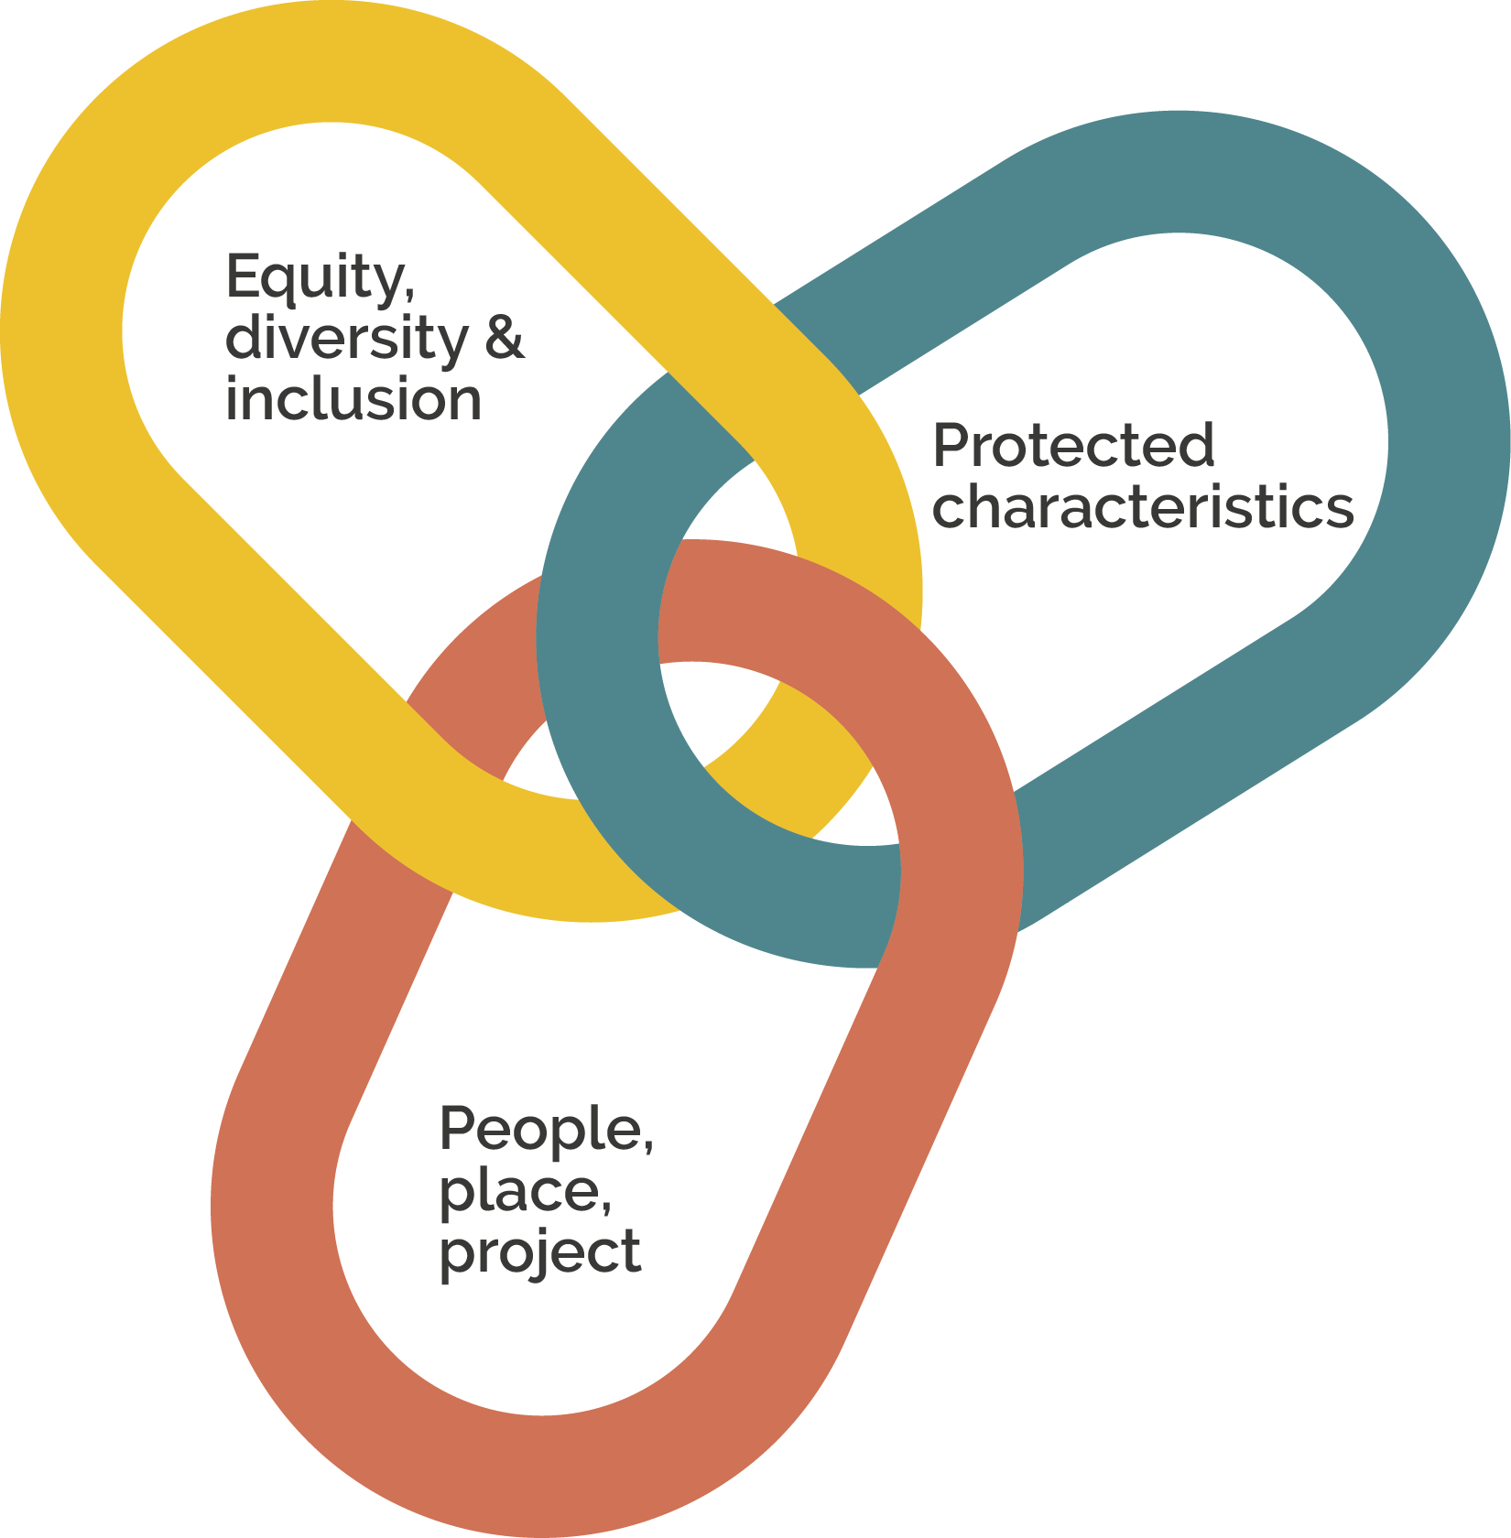
Links

Slide 3

Links: people, place, project

Slide 4
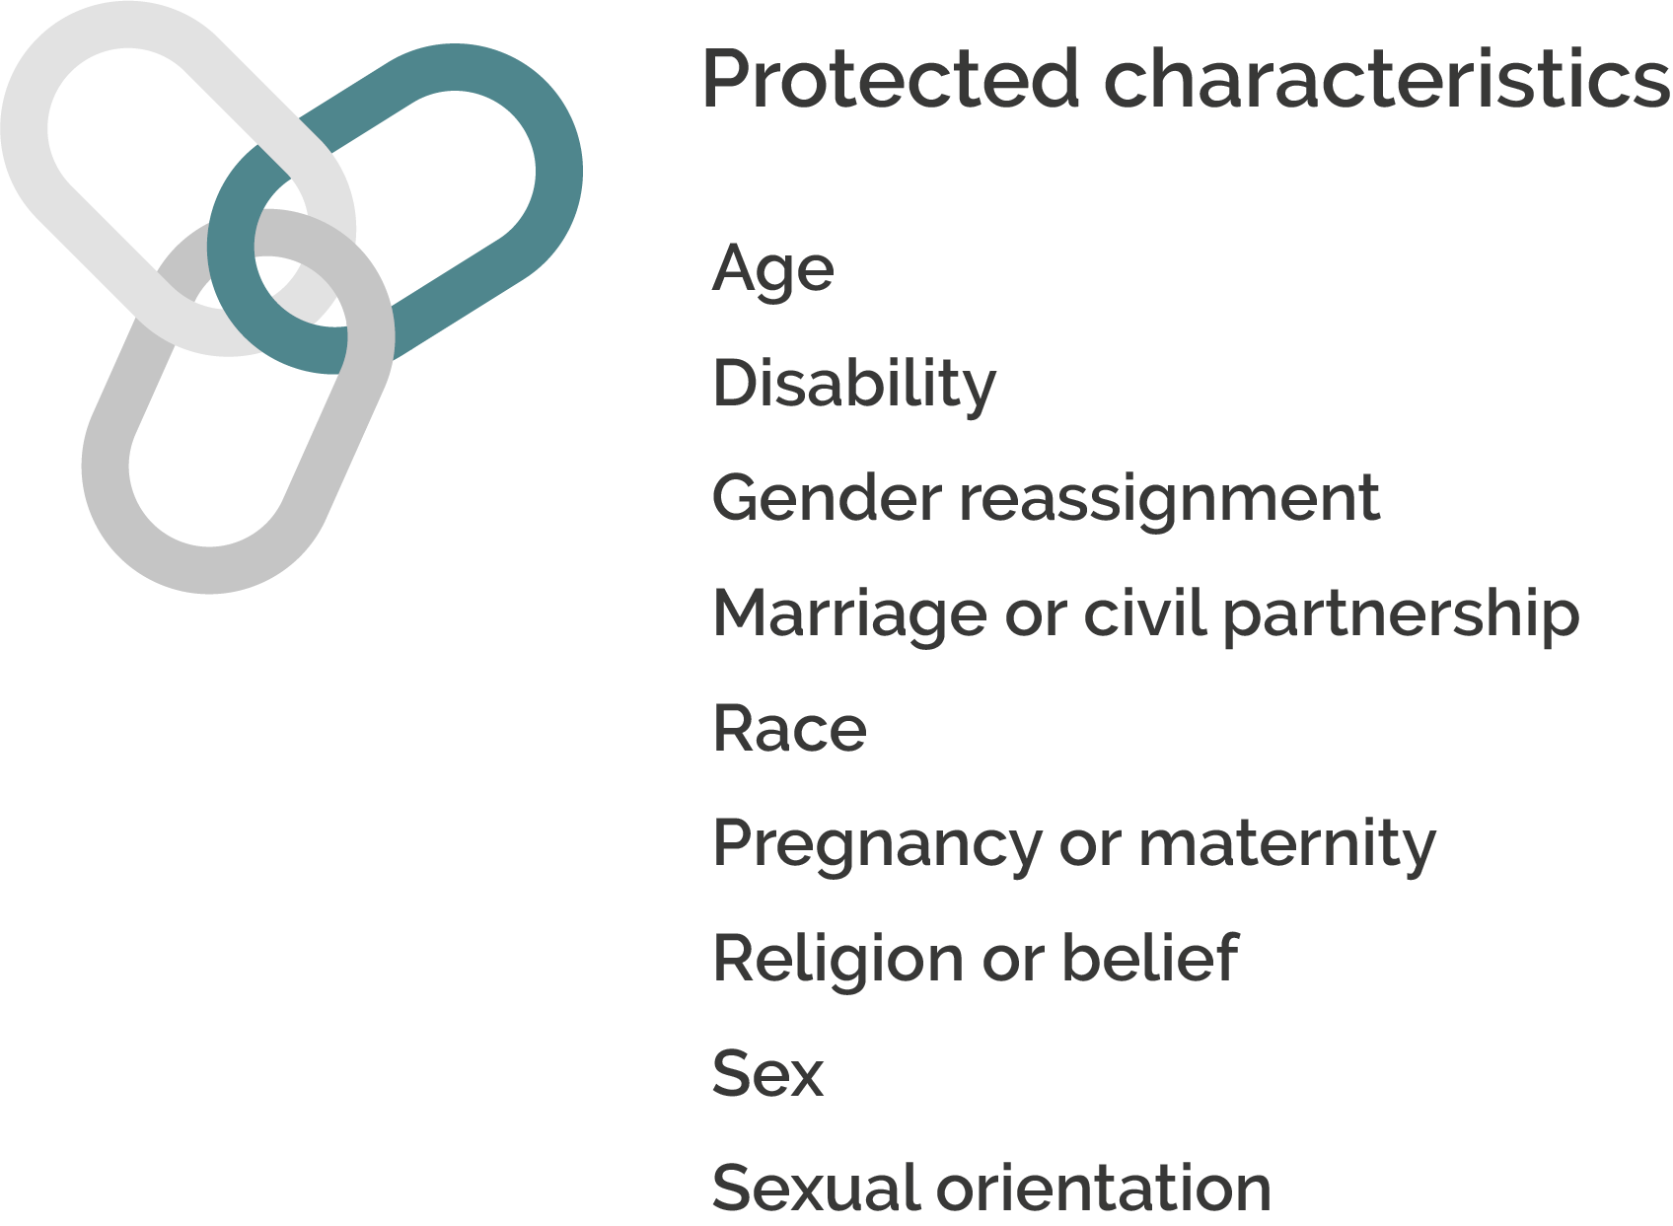
Links: protected characteristics

Slide 5

Links: equity, diversity & inclusion

Slide 6
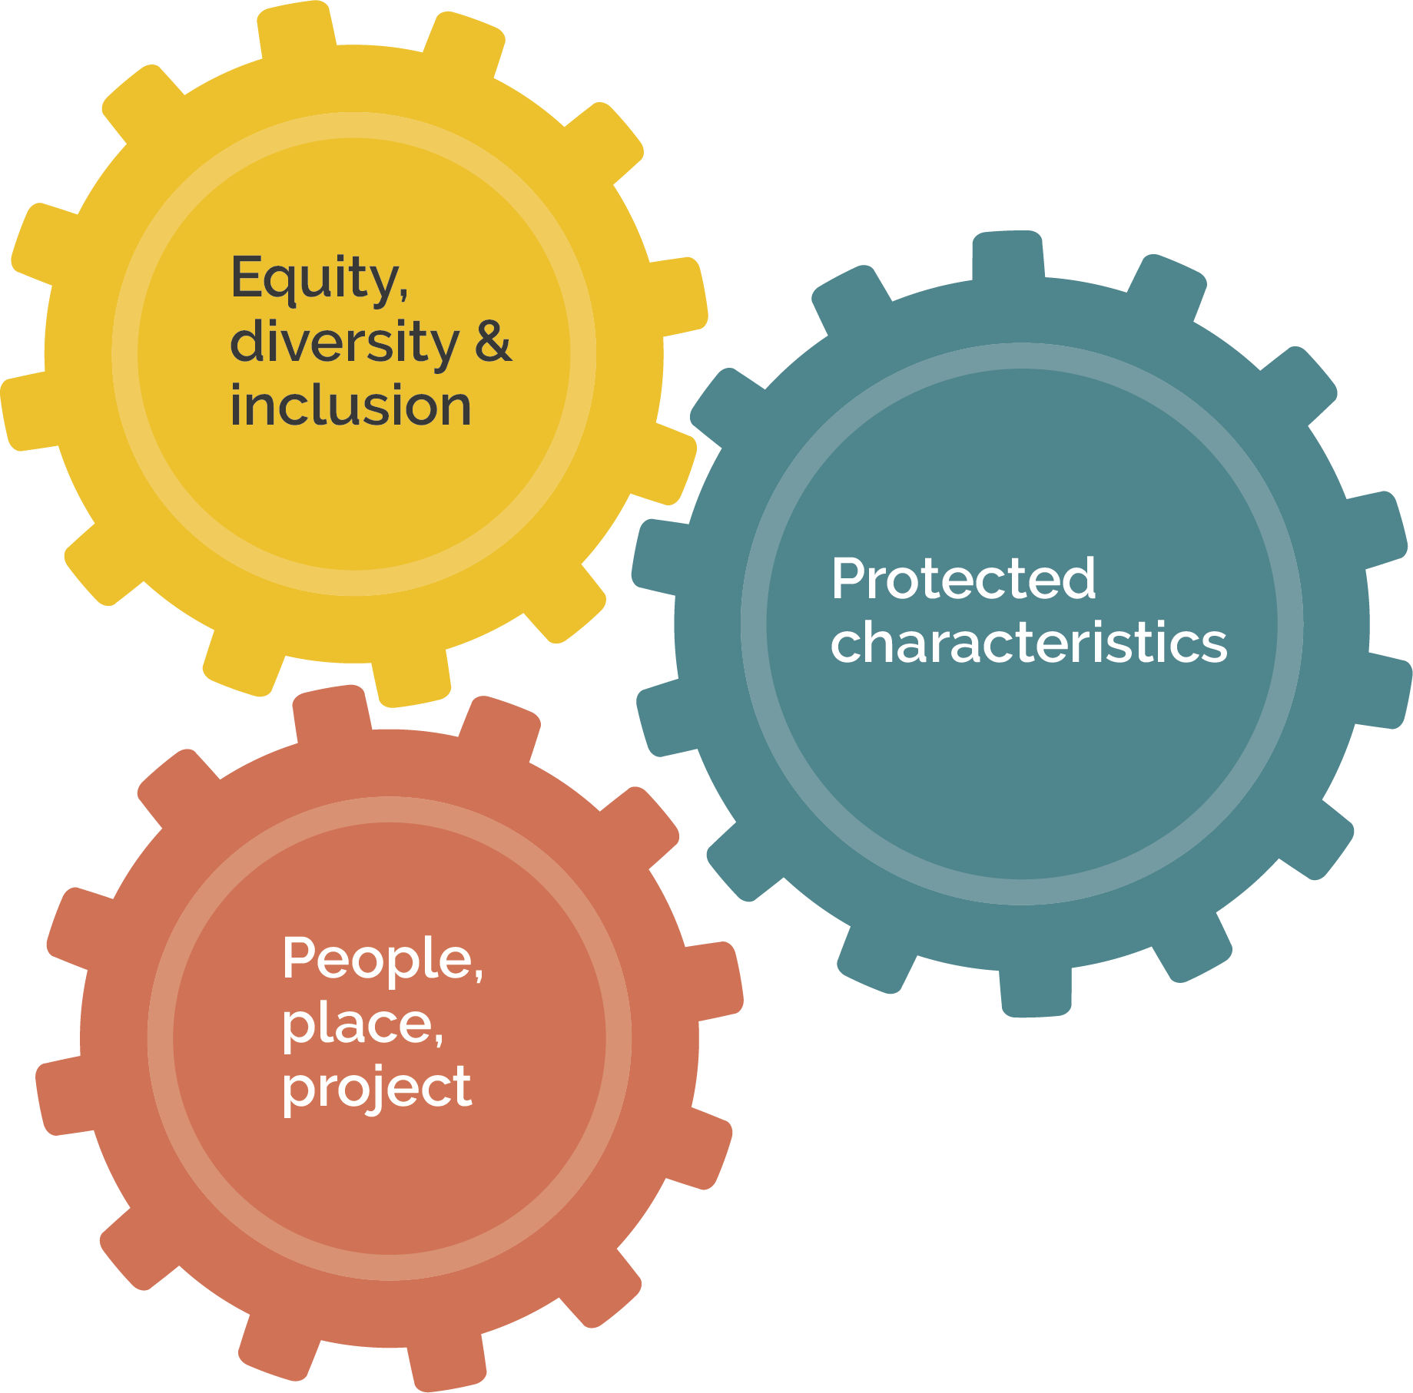
Cogs

Slide 7

Cogs: people, place, project

Slide 8
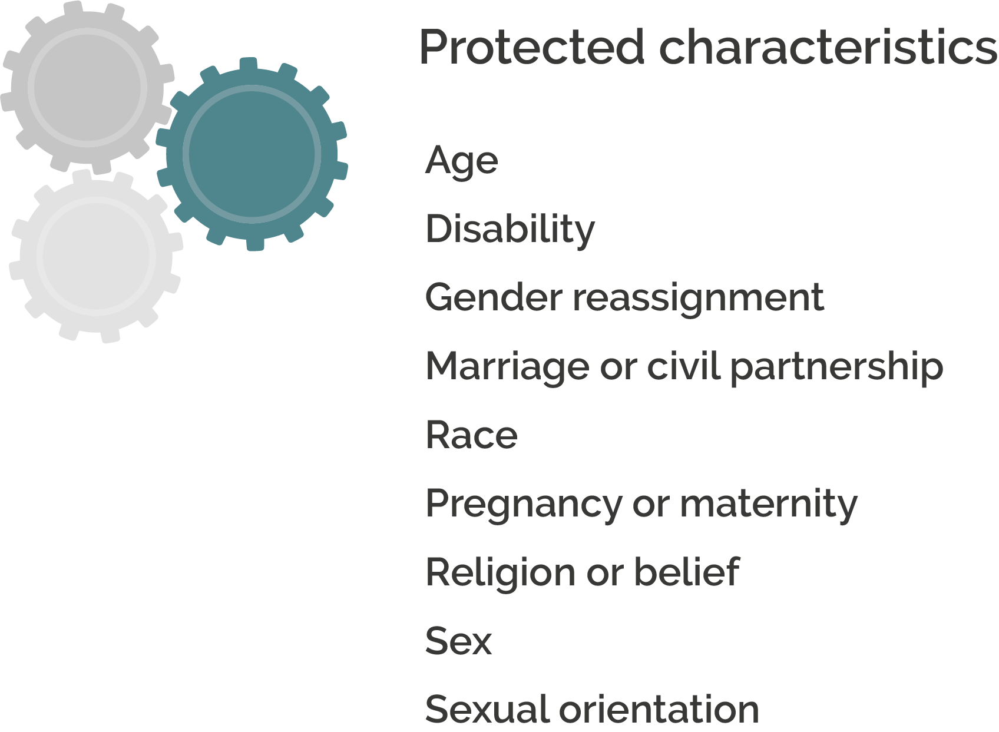
Cogs: protected characteristics

Slide 9

Cogs: equity, diversity & inclusion

