Slide 1
The EDI Cube A tool for thinking about EDI issues
Your name
Date

Slide 2
What is EDI?
Not merely an administrative, human resources or even moral concern
A fundamentally important determinant of who does what work, and how
A tool for making our research more relevant and likely to have greater impact’

Slide 3
What is EDI? cont…
A way of discovering new research gaps and improving the questions we ask
An increasingly significant requirement from funders
Beware of ‘EDI-washing’

Slide 4
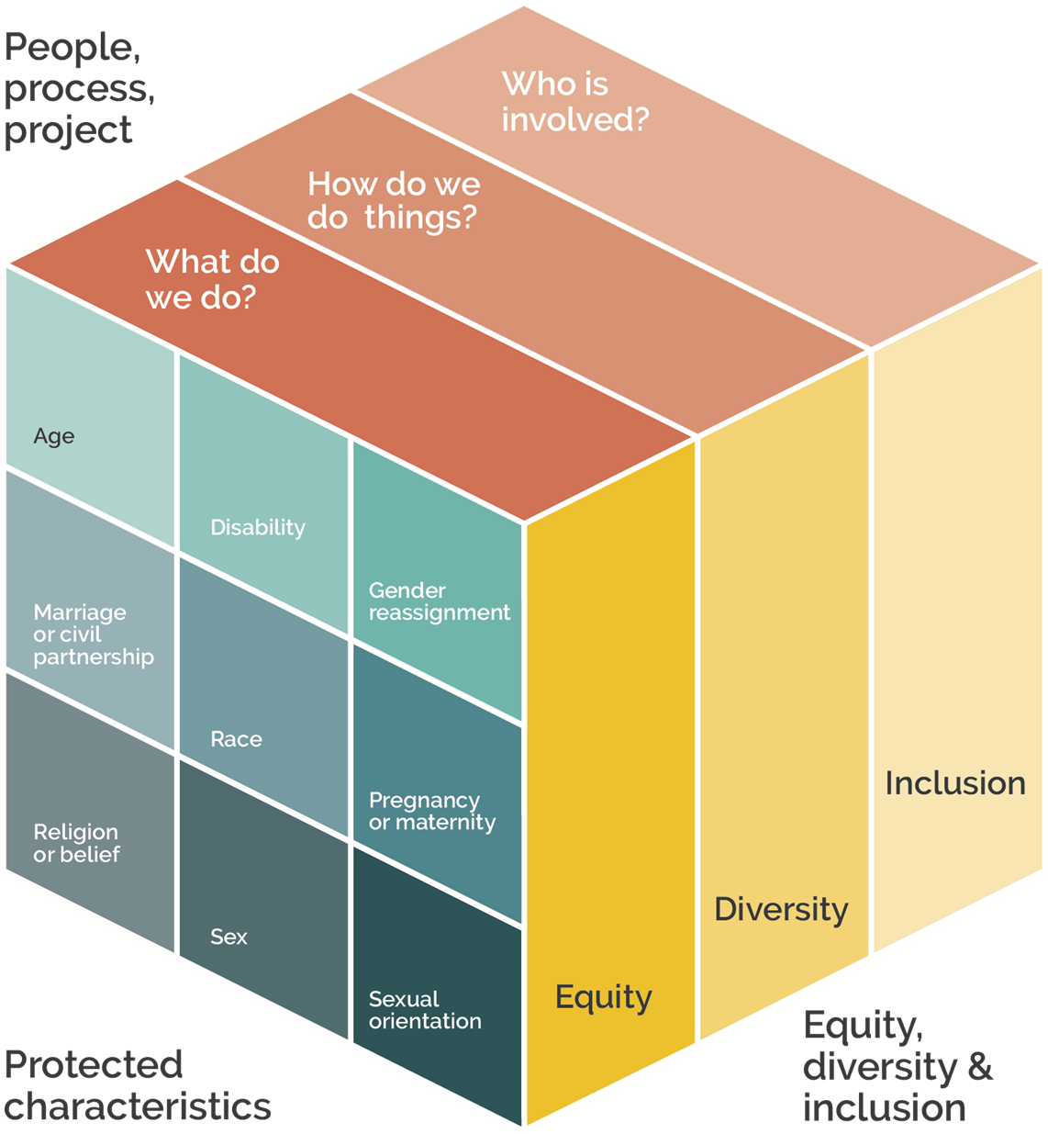
The concept
A tool to help design projects
A mnemonic device / visual aid
Different dimensions captured

Slide 5
The difference between equality & equity
Equality: everyone gets the same opportunity in the same way
Equity: opportunities are shaped to fit with the needs of individual

Slide 6
The difference between equality & equity cont…
Equality is about the availability of opportunity
Equity is about the accessibility of opportunity

Slide 7
Diversity
Diversity is about differences, visible and invisible
Everyone should be recognised, respected, valued, promoted and celebrated, whether or not their differences are protected by law
More than tolerance, a diverse workforce is not enough, need a sense of belonging

Slide 8
Inclusion
Inclusion is about creating that sense of belonging

Slide 9
Inclusion cont…
Tackling systemic inequality, creating systems that work for everybody (diagram)
Can include addressing past, present and potential discrimination and barriers
Standards, e.g. BSI and ISO (human resources), Investors in People (IiP) and Athena Swan

Slide 10
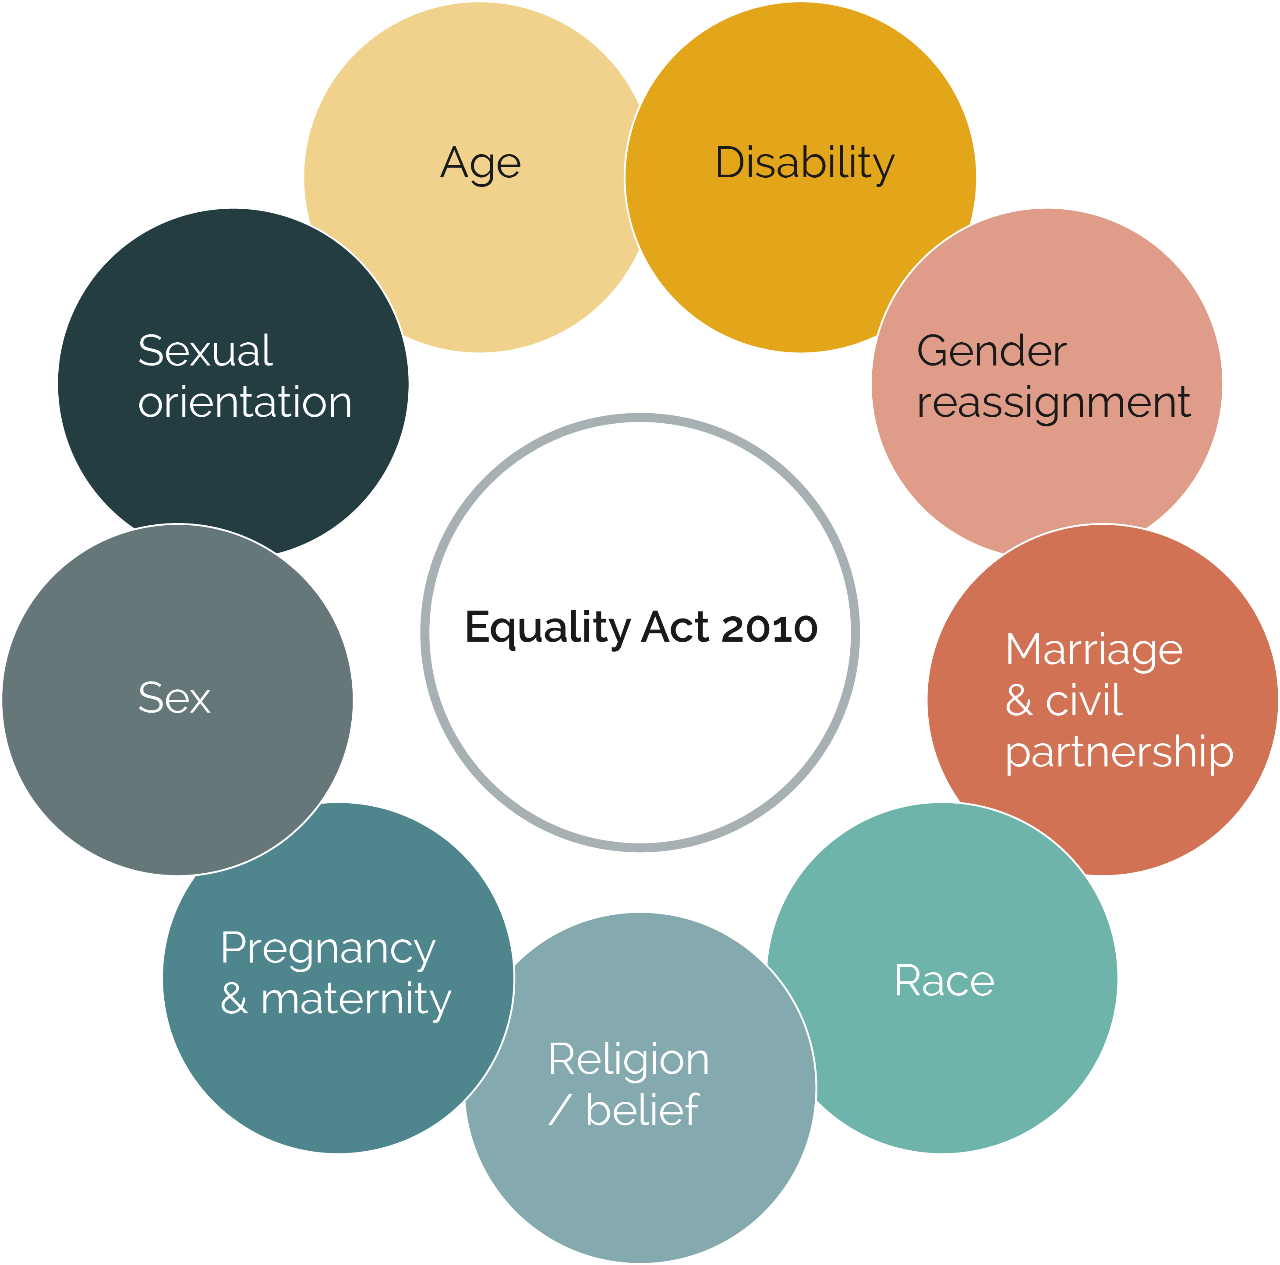
Protected characteristics
Image adapted from Gesche Huebner, 2023

Slide 11
Protected characteristics cont…
Equality Act 2010 (see Equality and Human Rights Commission)
Nine protected characteristics: age, disability, gender reassignment, marriage and civil partnership, pregnancy and maternity, race, religion or belief, sex, and sexual orientation

Slide 12
Protected characteristics cont…
Not comprehensive: Class, caste, socio-economic status, educational attainment (including the level of education achieved by your parents)
Intersectionality: people have multiple, overlapping identities, including multiple discrimination and disadvantage, no ‘one-size-fits all’ approach, need to achieve fairness and equality of opportunity and outcomes for everyone

Slide 13
The three Ps
Applying EDI to your work:
People: Who is doing the work?
Process: How is it being done?
Project (or programme): What subject is under investigation?

Slide 14
Case study
Chima Michael Anyadike-Danes (2022)
Whose witnesses: An examination of the potential pitfalls of producing electronic vehicle futures through experimentation. In: Experimentation for sustainable transport? Risks, strengths, and governance implications. Linnefors Förlag. (pp 117-131)

Slide 15
Case study cont…
Case study critiques an experimental / pilot approach to installing publicly accessible EV charging points in County Durham, UK in 2021 – SOCSI (Scaling on Street Charging Infrastructure)
Scientific method presented as producing knowledge that is objective and free of bias but this ignores knowledge claims of those situated differently

Slide 16
Description of project
Government vision of charging to be done at home, in driveway, off-peak, using smart meters
Does not account for densely populated areas, where on-street parking is the norm and access to charging is not guaranteed

Slide 17
Description of project cont…
On-street / supermarket / petrol station charging expensive
SOCSI trying to address architectural inequality (5- minute walk of home)
Plan to use Council land in city centre to install charge points (addressing architectural inequality)
Wheelchair users’ needs not considered

Slide 18
Inclusion issues
2.5 million people in the UK are disabled by the transport system, leading to a reliance on private transport
Making all spaces inclusive vs. providing limited ‘disabled’ parking – revenue raising, mainly focused on fossil fuels

Slide 19
Inclusion issues cont…
How to create socially inclusive, decarbonised transportation futures
Considering needs not the same as supporting them

Slide 20
Exercise (groups of 5 or 6)
In your groups, use the cube to think about more inclusive ways of designing this scheme

Slide 21
Reflection (plenary)
Who are infrastructural systems normally created for?
Who normally does the designing?
Who else is excluded by this?
What skills are needed to operate these systems?

Slide 22
Reflection cont…
Where are these skills learned?
What resources are required to install such systems?
What resources are required to use such systems?
How are investment decisions made?

Slide 23
Consider your own projects
Spend some time on your own thinking about your own project idea
Are there any ‘cube combinations’ that open up new gaps in your research area?

Slide 24
Consider your own projects cont…
How does this influence who you work with, what data you collect and how you analyse it, what sort of methodology you adopt, how you engage with stakeholders, the kinds of impact you might expect?
What are the resource implications of doing things this way (what time, money, knowledge, skills do you need)?

Slide 25
Final thoughts (plenary)
Any new project ideas?
Reflections on the exercise

Slide 26
Contacts
Sarah Higginson: sarah.higginson@ouce.ox.ac.uk
Higginson, S. (2023). The EDI Cube: A toolkit for project design, evaluation and teaching. Centre for Research into Energy Solutions (CREDS), University of Oxford.

